Slide 1
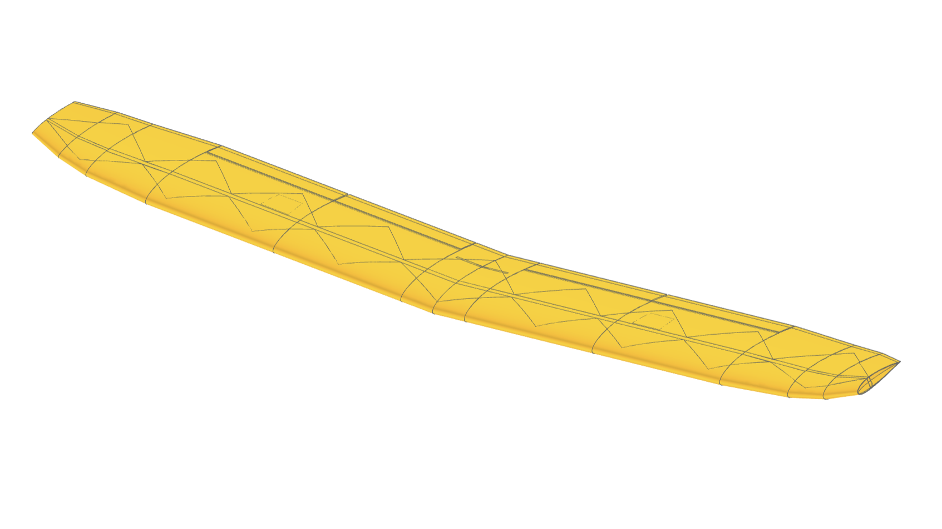
tip segment #6
servo
#5
trailing edge device
#4
seg. #3
segment #2
spare 1
segment #1
spare 0 (main spare)
#0
root segment 0
nose point

Slide 2
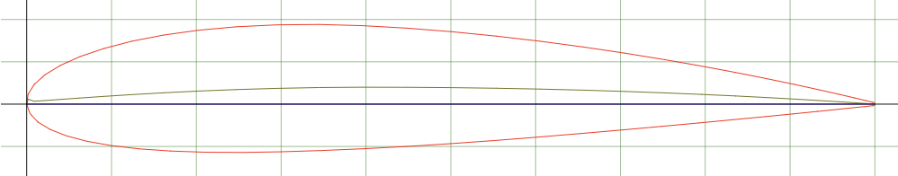
maximum thickness
upper camber
mean camber
line
upper surface
camber
leading edge
incidence
angle
0.0 relative
chord
chord
line
lower camber
trailing edge
lower surface
camber
chord
length
1.0 relative
chord

Slide 3
incidence
angle
0.0
rotation point
relative chord

Slide 4
incidence
angle
0.3
rotation point
relative chord

Slide 5
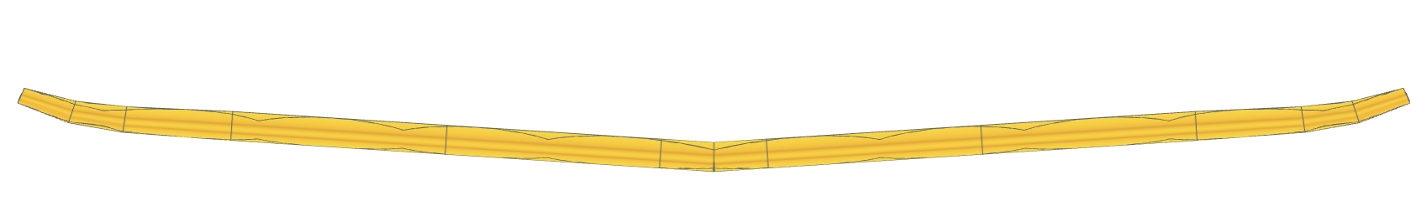
angle of dihedral
tip
tip
root

Slide 6
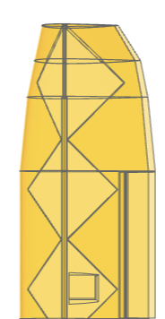
sweep
sweep
sweep

Slide 7
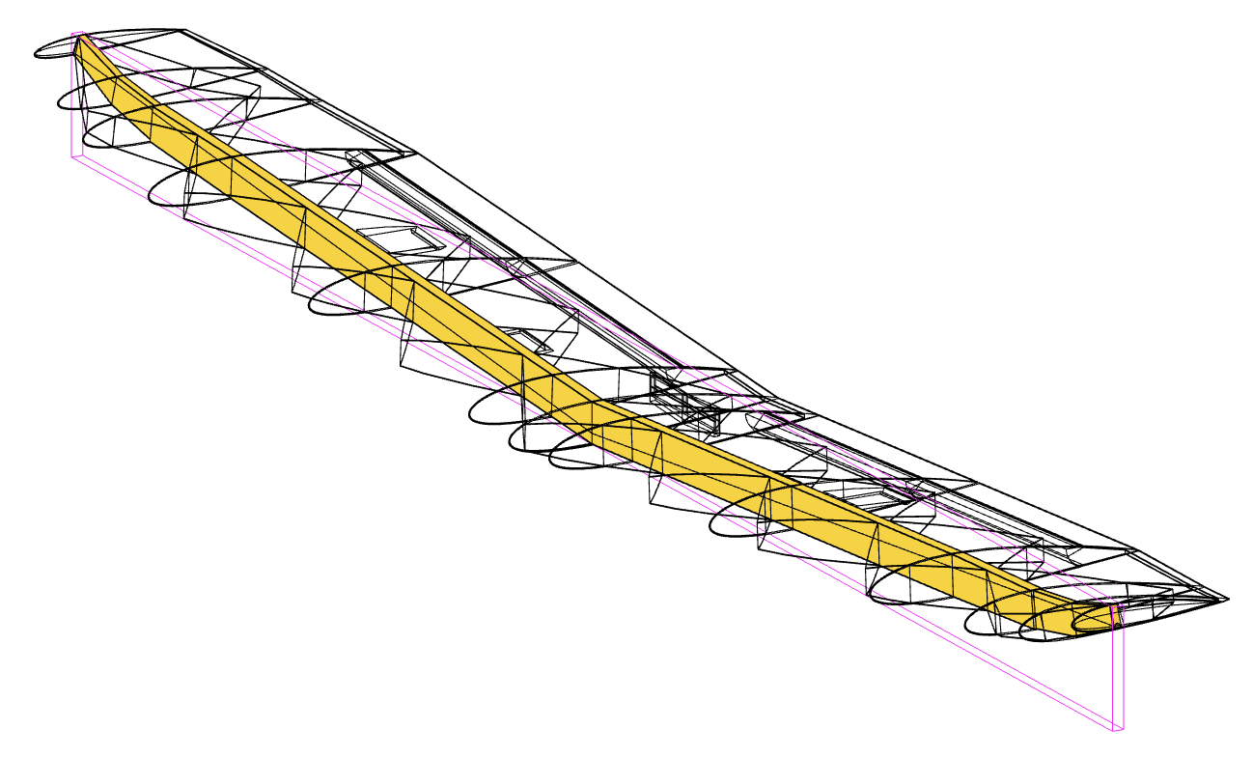

Slide 8
